Slide 1
Population genomics and morphological variation in the terrestrial gastropod Webbhelix multilineata (Mollusca: Gastropoda: Polygyridae)
Iowa State University Dissertation Defense
Jermaine Mahguib

Slide 2
Dissertation Overview
Introduction
Webbhelix multilineata
Habitat and species range
Genomics
Chapter 1 – Minimum sample sizes for population genomics
Chapter 2 – Population genomics of Webbhelix
Chapter 3 – Morphological variation in Webbhelix
Summary and concluding remarks
Acknowledgements

Slide 3
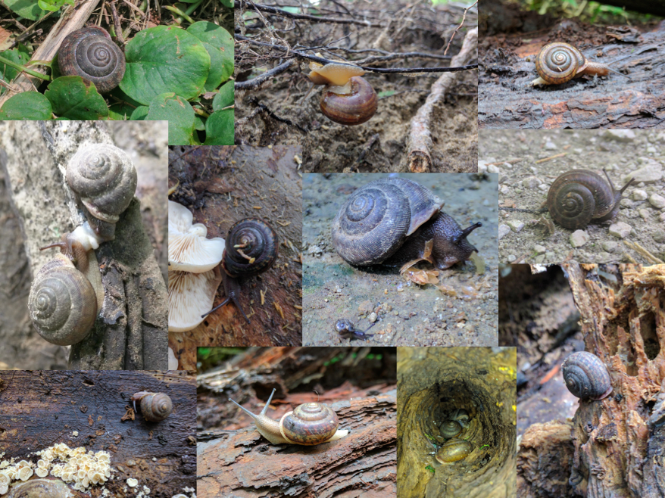

Slide 4
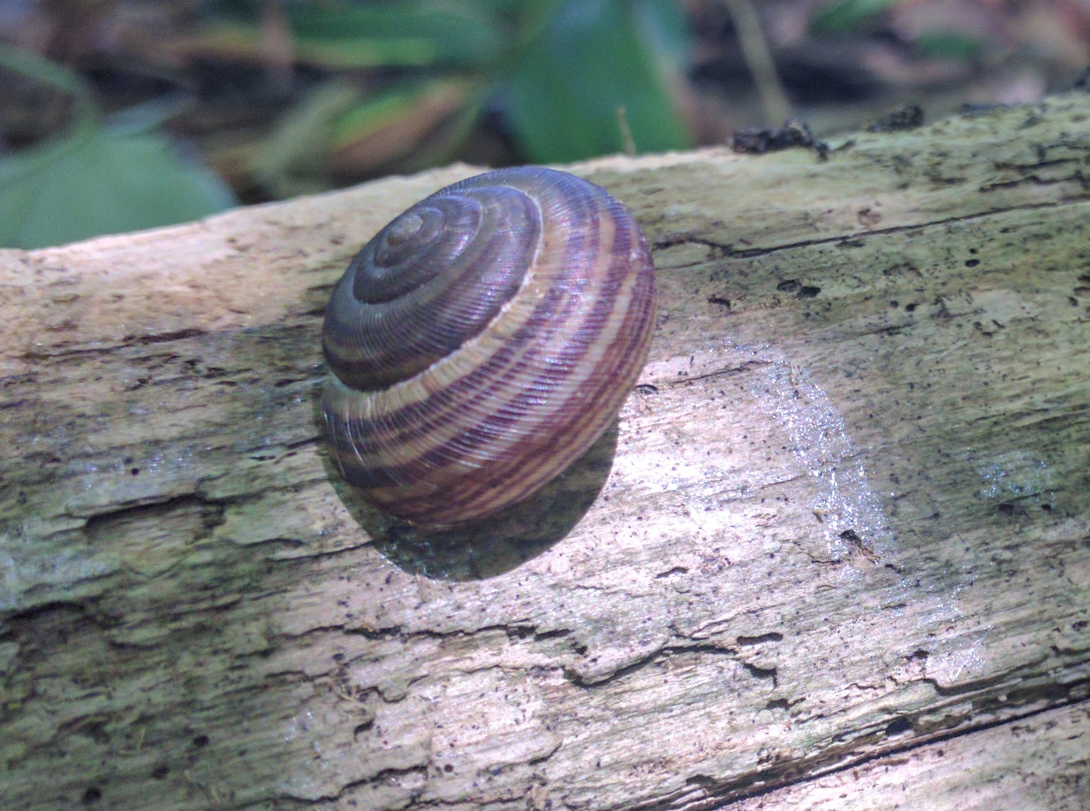
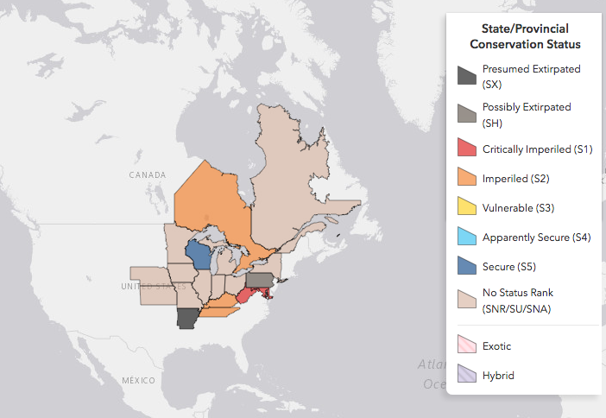
Webbhelix multilineata
Terrestrial gastropod (Polygyridae)
Simultaneous hermaphrodites
Very broad range
Habitat restricted

Slide 5
Genomics
Single nucleotide polymorphisms (SNPs)
Large number of markers from across the genome
Availability of datasets open up research opportunities for taxa

Slide 6
Minimum Sample Sizes for Population Genomics

Slide 7
Chapter Overview
Generating SNP data
Genomic method
Preliminary populations
Stacks core parameter optimization
Population resampling and subsampling treatments
Genetic diversity estimation and comparison of treatment mean estimates

Slide 8
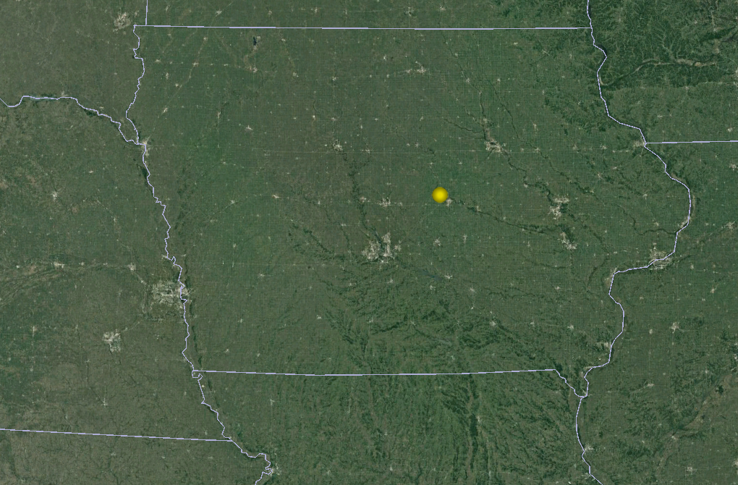
Generating SNP Data: Genomic Method & Preliminary Populations
Reduced genome approach
ddRADseq
TGCP, PTP, MPO & STT
Stacks pipeline
Iowa
TGCP
Nebraska

Slide 9
Generating SNP Data: Genomic Method & Preliminary Populations
Reduced genome approach
ddRADseq
TGCP, PTP, MPO & STT
Stacks pipeline
Iowa
TGCP
Nebraska
WE ARE HERE

Slide 10
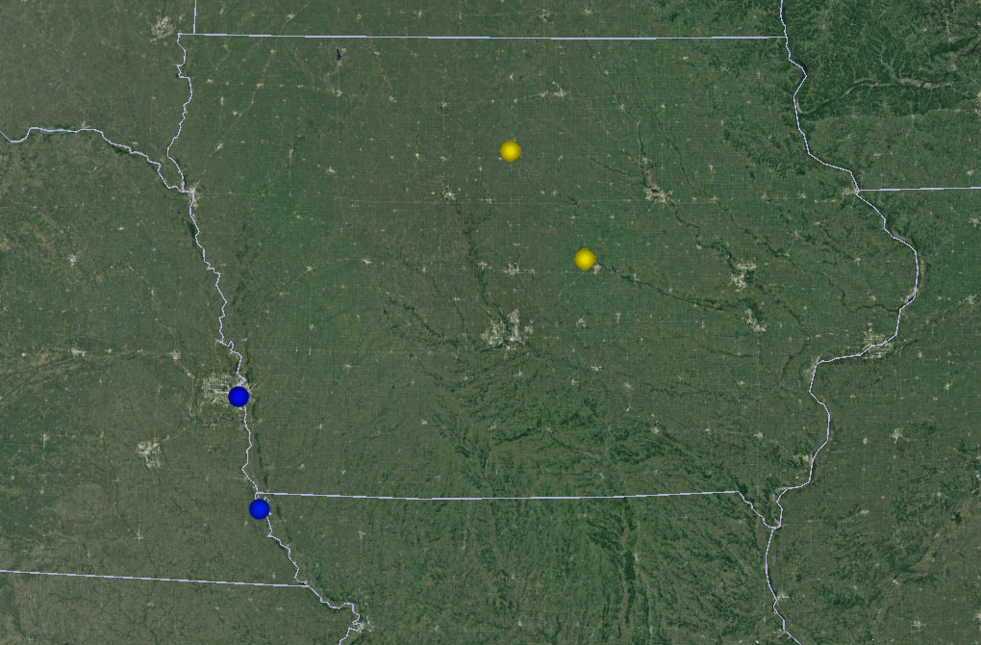
Generating SNP Data: Genomic Method & Preliminary Populations
Reduced genome approach
ddRADseq
TGCP, PTP, MPO & STT
Stacks pipeline
Iowa
PTP
TGCP
Nebraska
MPO
STT

Slide 11
SNP Data: Stacks Core Parameter Optimization
Mastretta-Yanes et al, 2015; tested core set of parameters for optimal combo based on SNP error rate
m (min. # identical raw reads to create a stack)
M (# mismatches allowed btw. loci in an individual)
mls (max. # stacks at a de novo locus)
n (# mismatches allowed btw. loci for building catalog)

Slide 12
Why Test for Minimum Sample Sizes?
Nazareno et al, 2017
System-specific minimums
Reduce sequencing costs

Slide 13
Population Resampling & Subsampling Treatments
Custom Python script to resample populations
Resampled 4 populations of 24 individuals for 11 subsampling treatments…
22subsamp – 14subsamp – 6subsamp
20subsamp – 12subsamp – 4subsamp
18subsamp – 10subsamp – 2subsamp
16subsamp – 8subsamp
Resampled 100 times for each treatment; total of 1,100 resampled data files

Slide 14
Original Data File
Population 1
Sample 1
Sample 2
Sample 3
Sample 4
Sample 5
Sample 6
Population 2
Sample 7
Sample 8
Sample 9
Sample 10
Sample 11
Sample 12
Population 3
Sample 13
Sample 14
Sample 15
Sample 16
Sample 17
Sample 18

Slide 15
Original Data File
New Data File
Population 1
Sample 1
Population 1
Sample 2
Sample 1
Sample 3
Sample 3
Sample 4
Sample 5
Sample 5
Sample 6
Sample 6
Run
Custom
Python
Script
Population 2
Sample 7
Population 2
Sample 8
Sample 7
Sample 9
Sample 8
Sample 10
Sample 10
Sample 11
Sample 12
Sample 12
Population 3
Sample 13
Population 3
Sample 14
Sample 13
Sample 15
Sample 16
Sample 16
Sample 17
Sample 17
Sample 18
Sample 18

Slide 16
Original Data File
New Data File
Population 1
Sample 1
Sample 2
Population 1
Sample 3
Sample 2
Sample 4
Sample 5
Sample 5
Sample 6
Run
Custom
Python
Script
Population 2
Sample 7
Sample 8
Population 2
Sample 9
Sample 9
Sample 10
Sample 12
Sample 11
Sample 12
Population 3
Sample 13
Sample 14
Population 3
Sample 15
Sample 16
Sample 16
Sample 17
Sample 17
Sample 18

Slide 17
Population Resampling & Subsampling Treatments
Custom Python script to resample populations
Resampled 4 populations of 24 individuals for 11 subsampling treatments…
22subsamp – 14subsamp – 6subsamp
20subsamp – 12subsamp – 4subsamp
18subsamp – 10subsamp – 2subsamp
16subsamp – 8subsamp
Resampled 100 times for each treatment; total of 1,100 resampled data files

Slide 18
Genetic Diversity Estimation & Treatment Means Comparison
Estimated H_{O} , H_{S} , G_{IS} and pairwise F_{ST} for all 1,100 datasets using GenoDive
Collated all estimates
Statistically compared subsampling treatment estimate means using Analysis of Variance (ANOVA) and Kruskal-Wallis Rank Sum Tests

Slide 19
Genetic Diversity Estimation & Treatment Means Comparison
ANOVA results indicated that across all parameters, a minimum of 6 individuals per population was required for accurate estimates
Data not normally distributed
Non-parametric Kruskal-Wallis Rank Sum and T-Tests corroborated results; 6 individuals per pop no different than using 8 – 22 individuals per pop

Slide 20
Population Genomics of Webbhelix multilineata

Slide 21
Chapter Overview
Species range and past glacial periods
Sample localities and SNP dataset
Assessment of genetic structure & differentiation
Genetic diversity estimation and isolation by distance
Relative migration rates
Evaluation of post glacial refugial expansion

Slide 22
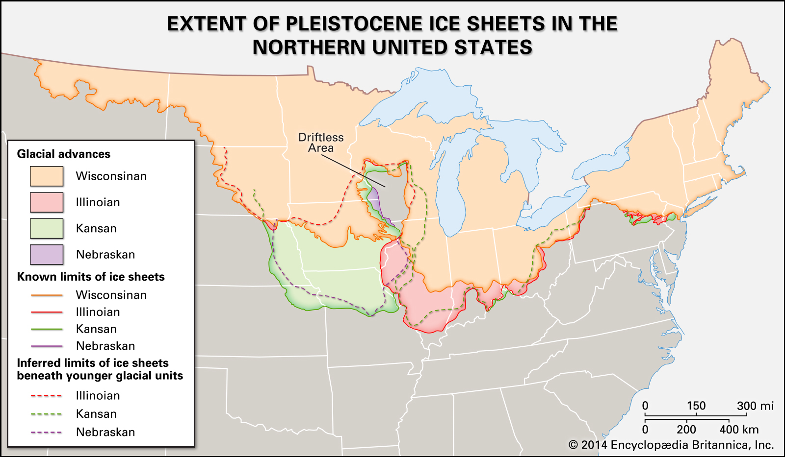
Species Range & Past Glacial Periods
North America has experienced repeated past glaciations that grow south & recede north, causing species ranges to contract and expand
Webbhelix has a broad range that encompasses previously glaciated regions

Slide 23
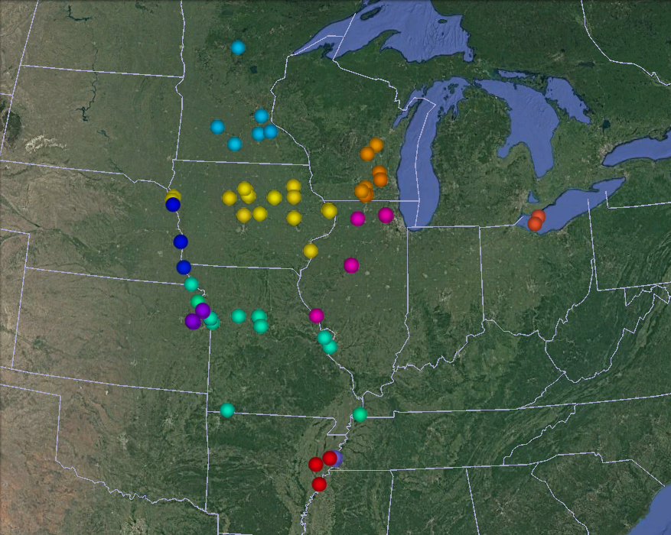
Minnesota
Wisconsin
Ontario
Nebraska
Iowa
Illinois
Kansas
Missouri
Tennessee
Arkansas

Slide 24
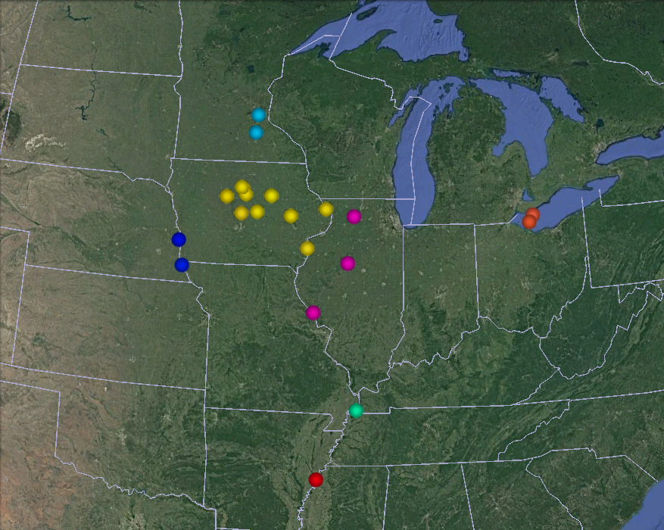
Minnesota
FSSP
CRWA
Ontario
HGRF
PTP
OICP
PPFD
BHP
PCRA
PPNP
Nebraska
NRVP
RRO
TGCP
MRLP
FPPI
MPO
Iowa
IRO
CPS
STT
Illinois
RRL
Missouri
DHFA
Arkansas
HNL

Slide 25

Minnesota
Ontario
Nebraska
Iowa
Illinois
Missouri
Arkansas

Slide 26
Sample Localities & SNP Dataset
Generated SNP data from 18 sample localities
Stacks pipeline with optimal core parameter settings used for SNP discovery
Plink program used to filter SNPs in high LD pairs and extreme deviants HWE
Total of 8,480 SNPs kept as primary dataset

Slide 27
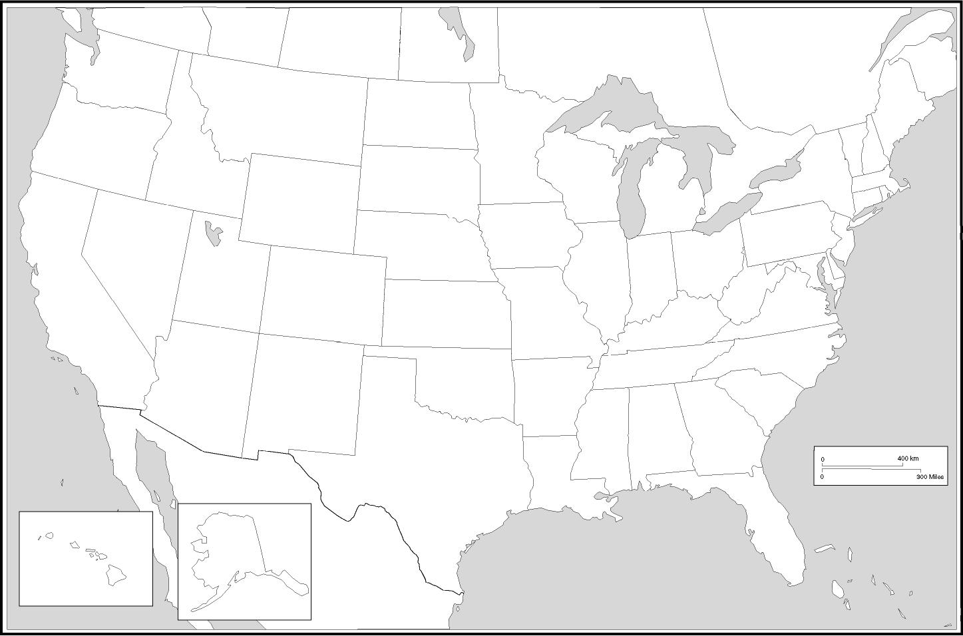
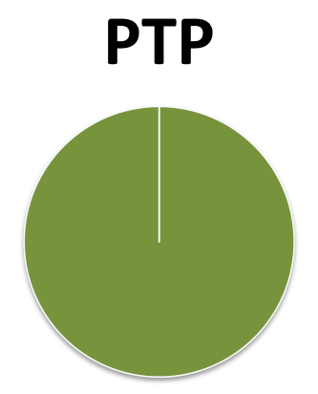
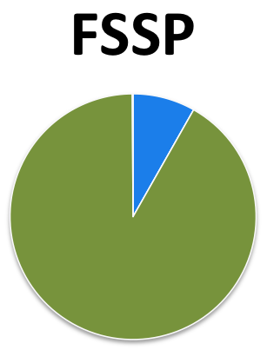
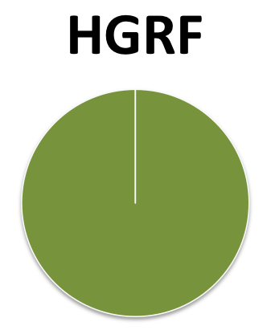
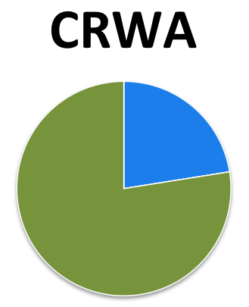
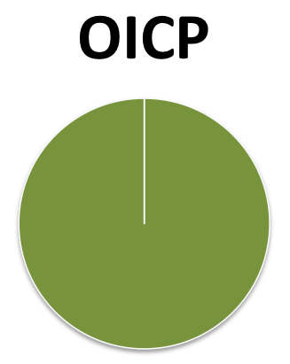
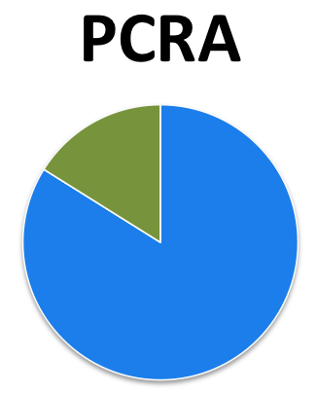
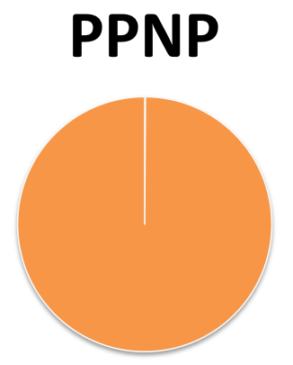
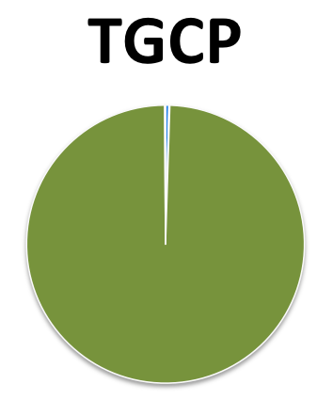
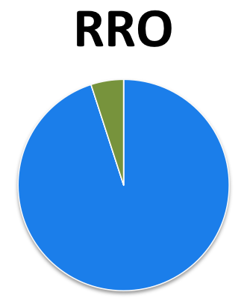
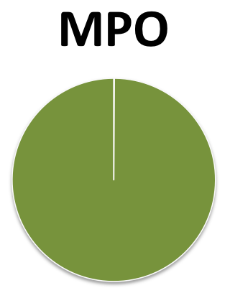
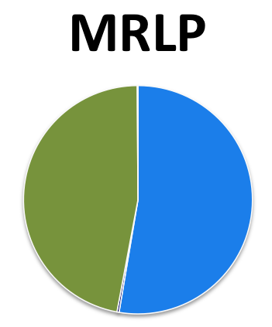
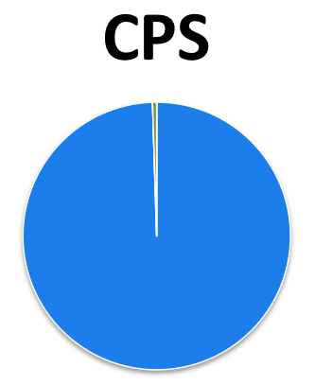
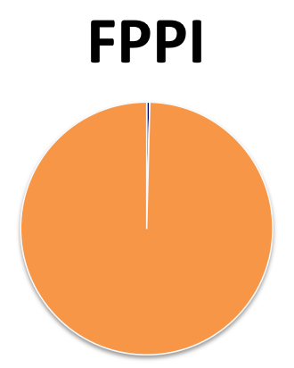
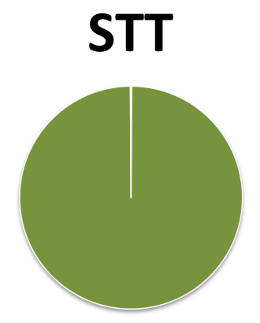
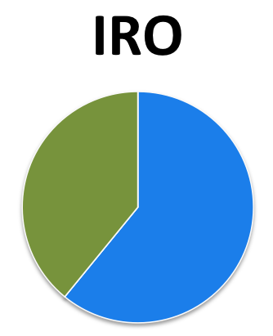
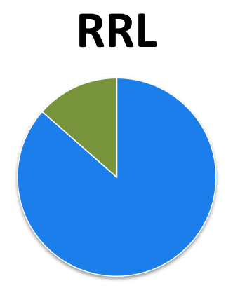
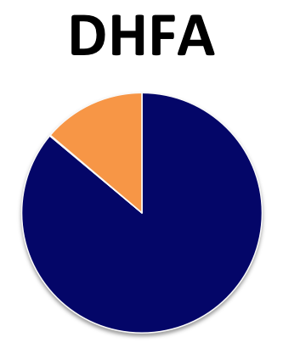
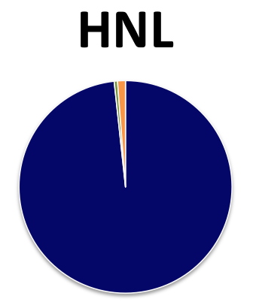
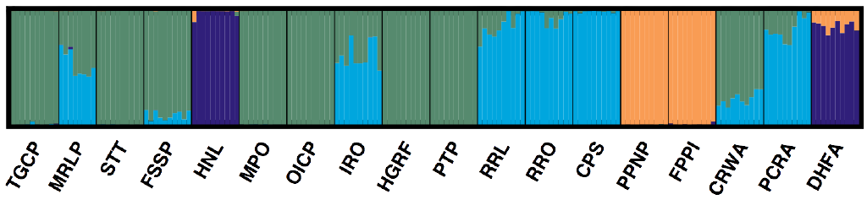
Assessed population genomic structure using the program STRUCTURE
18 sample localities, 178 individual Webbhelix
10 individuals per sample locality
Tested K1 – K18, 20 iterations each
100,000 burn-in & 500,000 MCMC
K4 most likely number of true populations, based on highest Delta K and smaller Stdev LnP(K) (model choice criterion) than next highest Delta K

Slide 28
Pairwise F_{ST} estimated for STRUCTURE population clusters
Little genetic differentiation between Clusters 1 & 2
10 individuals per sample locality
Tested K1 – K18, 20 iterations each
100,000 burn-in & 500,000 MCMC
K4 most likely number of true populations, based on highest Delta K and smaller Stdev LnP(K) (model choice criterion) than next highest Delta K
0.13
Cluster 1
Cluster
3
0.04
Cluster
2
0.10
0.13
0.11
0.17
Cluster 4

Slide 29
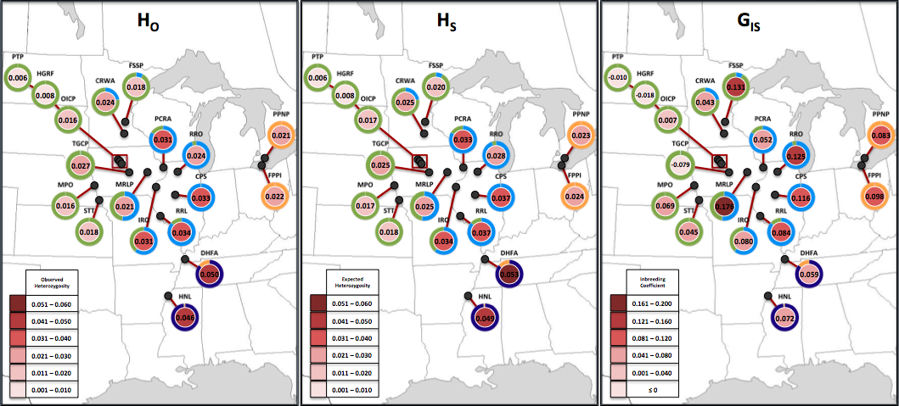
Genetic Diversity Estimates

Slide 30
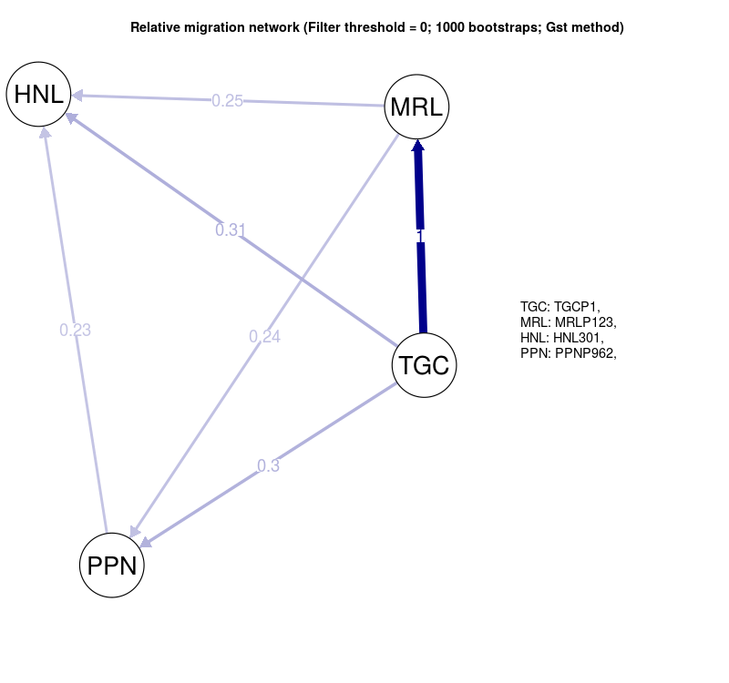
Relative Migration Network
(Filter threshold = 0; 1000 bootstraps; G_{ST} method)
STRUCTURE Population Clusters
(With relative migration rates)
C4
C2
Cluster 1
0.3
Cluster 2
0.24
C1
Cluster
3
0.25
1
0.23
0.31
Cluster 4
C3

Slide 31
DIYABC Simulations
Simulated scenarios of refugial expansion post most recent North American glaciation
Performed two rounds of simulations:
Time frame for expansion events from 10 to 5000 Webbhelix generations
Time frame for expansion events from 10 to 8000 generations

Slide 32
Expansion Model 1
Expansion Model 2
Expansion Model 3
1
1
1
2
3
2
3
2
3
4
4
4
DIYABC Scenario 1
DIYABC Scenario 2
DIYABC Scenario 3
t2
t2
t2
t1
t1
0
0
0
1
2
3
4
2
1
3
4
2
1
3
4

Slide 33
DIYABC Simulations
Simulated scenarios of refugial expansion post most recent North American glaciation
Performed two runs of simulations:
Time frame for expansion events from 10 to 5000 Webbhelix generations
Time frame for expansion events from 10 to 8000 generations
Each run performed ~1,500,000 simulations of data based on user inputted prior distributions of Ne and Time in generations

Slide 34
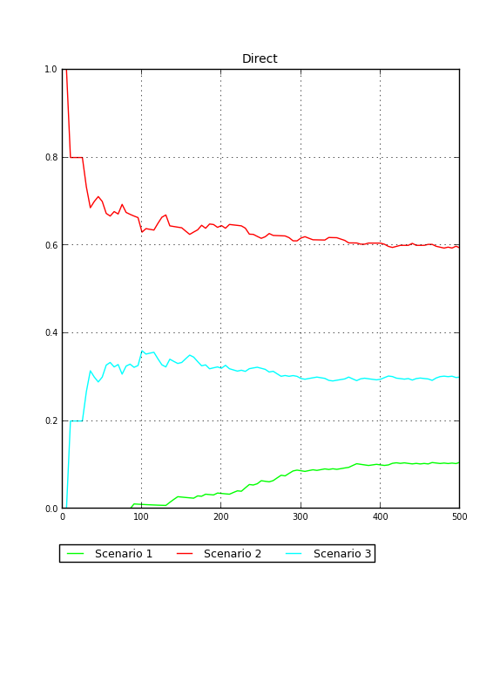
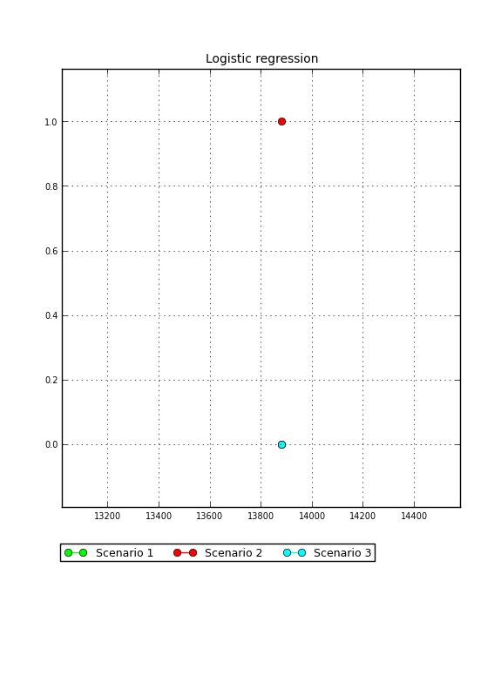
Computation of Posterior Probabilities of Scenarios (10 to 5000 gen)

Slide 35
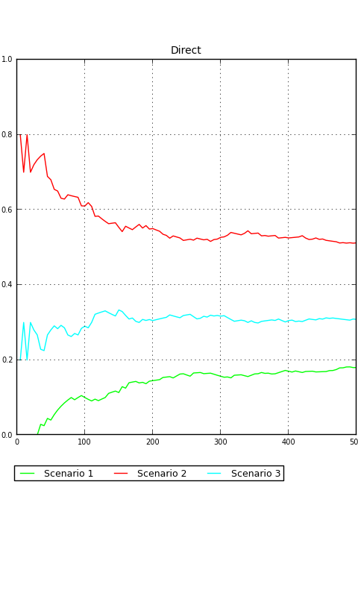
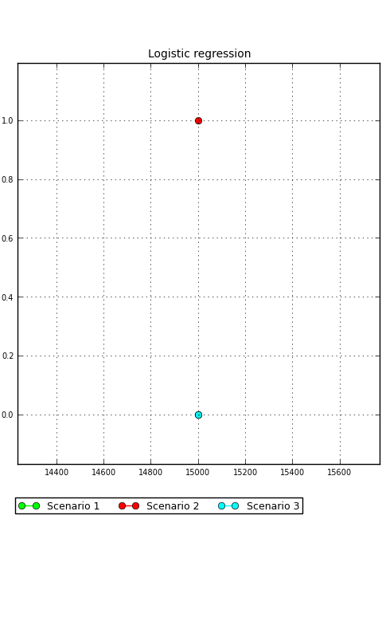
Computation of Posterior Probabilities of Scenarios (10 to 8000 gen)

Slide 36
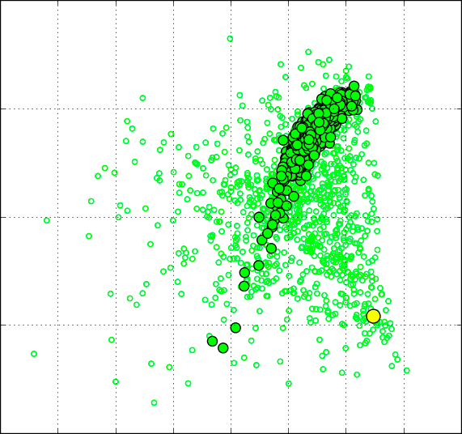
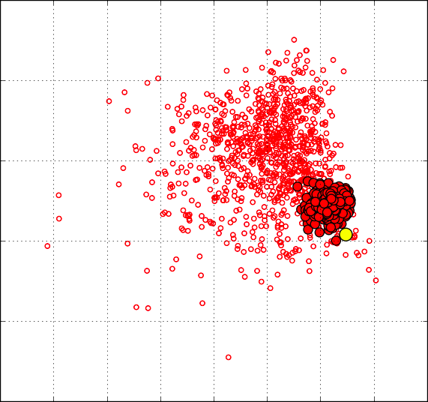
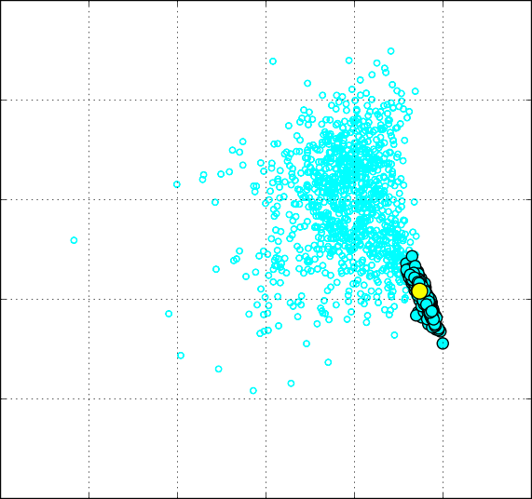
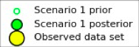
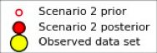
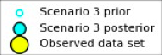
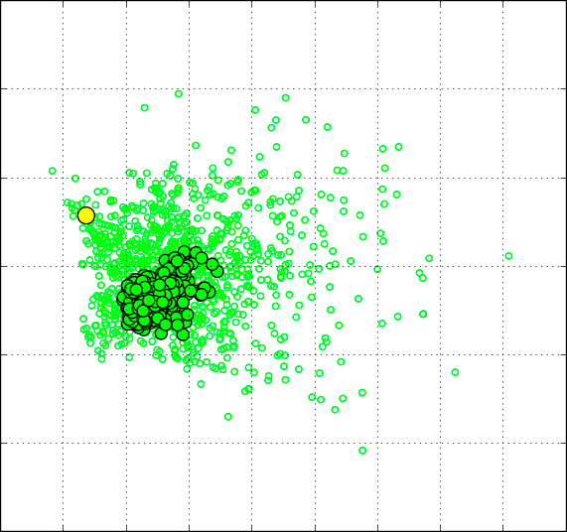
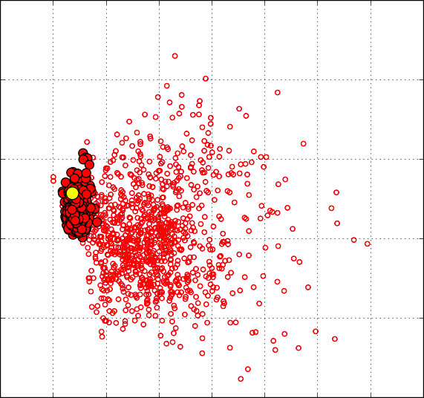
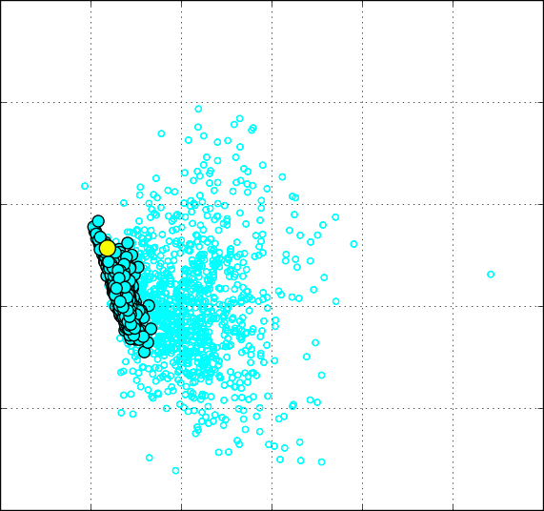
Time Frame: 10 to 5000 generations
DIYABC Scenario 1
DIYABC Scenario 2
DIYABC Scenario 3
10
10
10
5
5
5
0
0
P.C.2
0
-5
-5
-5
-10
-10
-10
-15
-15
-20
-15
-10
-5
0
5
10
-20
-15
-10
-5
0
5
10
-30
-20
-10
0
10
Time Frame: 10 to 8000 generations
10
10
10
5
5
5
0
0
P.C.2
0
-5
-5
-5
-10
-10
-10
-15
-15
-20
-15
-10
-5
0
5
10
-20
-15
-10
-5
0
5
10
-30
-20
-10
0
10
P.C.1
P.C.1
P.C.1

Slide 37
Morphological Variation in Webbhelix multilineata

Slide 38
Chapter Overview
Field observations of morphological variation
Ecogeographical hypotheses
Morphological data
Linear regression analyses
Correlation between genetic & morphological distance

Slide 39
Field Observations: Morphological Variation
Observed in the field that some sample localities seemed to have larger individuals, some had noticeably smaller individuals
Also noticed that some localities seemed to have individuals with heavier banding, making them appear darker

Slide 40
Ecogeographical Hypotheses
Testing common ecogeographical hypotheses
Bergmann’s Rule (for body size variation)
Gloger’s Rule (for body pigmentation)

Slide 41
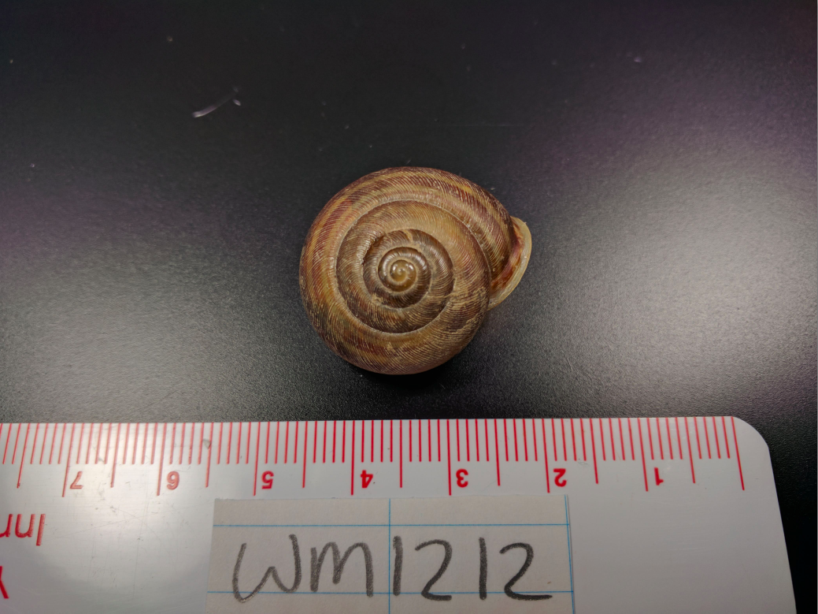
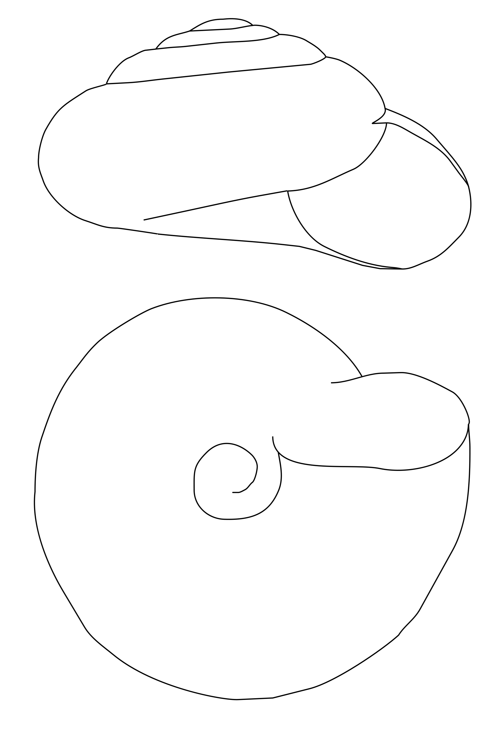
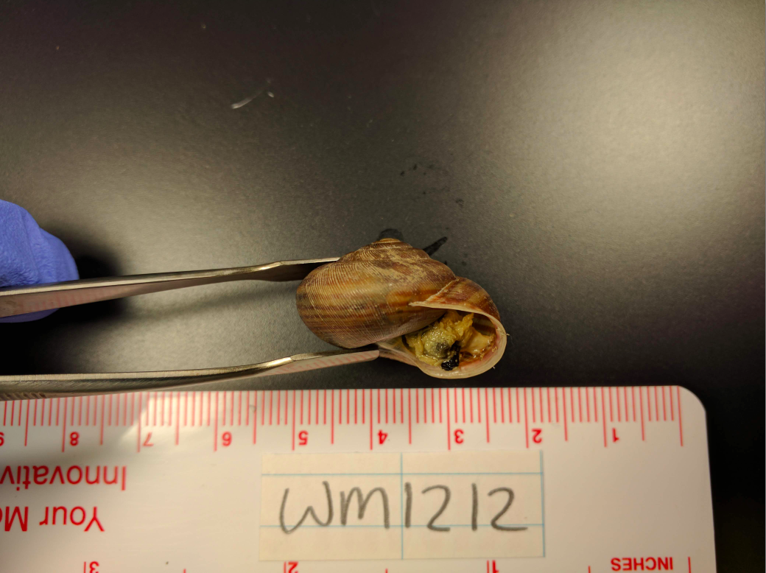
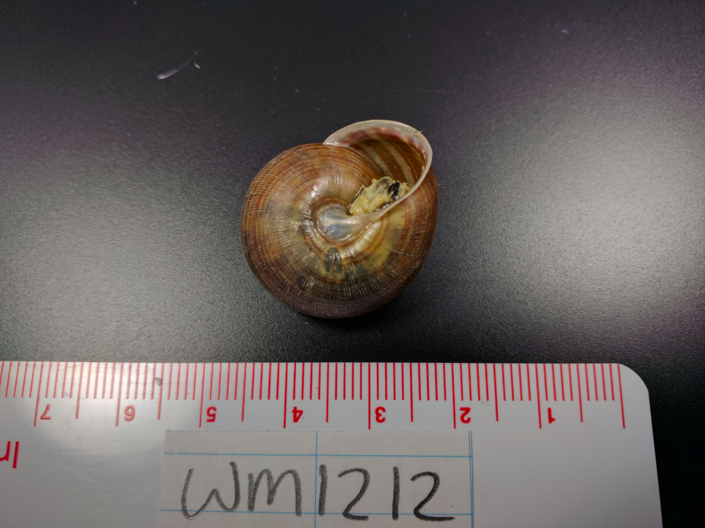
Morphological Data: Shell Size
Shell height
Shell width 1
Shell width 2

Slide 42
Morphological Data: Shell Size
Digital calipers were used to measure shell dimensions
Total of 410 adult Webbhelix shells were measured for width 1, width 2 and height

Slide 43
Morphological Data: Shell Brightness
Total of 268 adult Webbhelix shells were selected for assessing a proxy measure for shell brightness
Shells were cleaned and mounted for photographing a lateral view
Digital images were analyzed using ImageJ

Slide 44
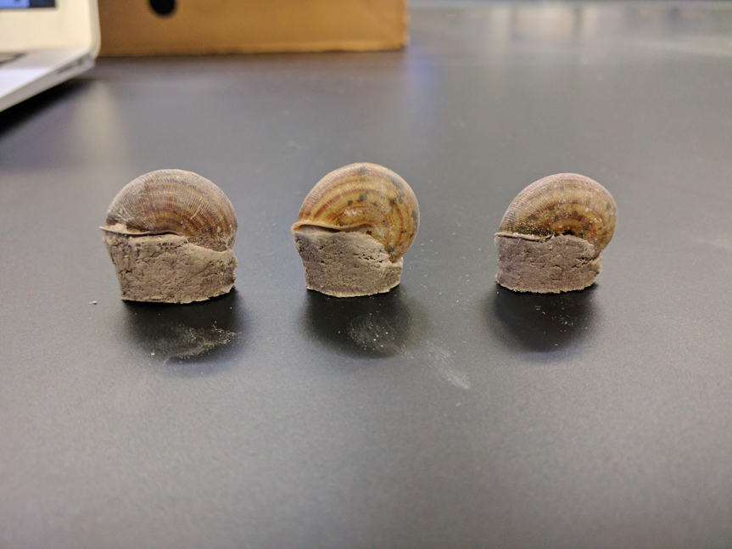
Morphological Data: Shell Brightness
Shells mounted on gray clay molds, placed on color calibration cards
Aperture setting of camera set to F18 and the ISO was set to 100 to preserve as much image detail as possible
Camera shutter speed set to ¼ of a second to increase exposure (image brightness)

Slide 45
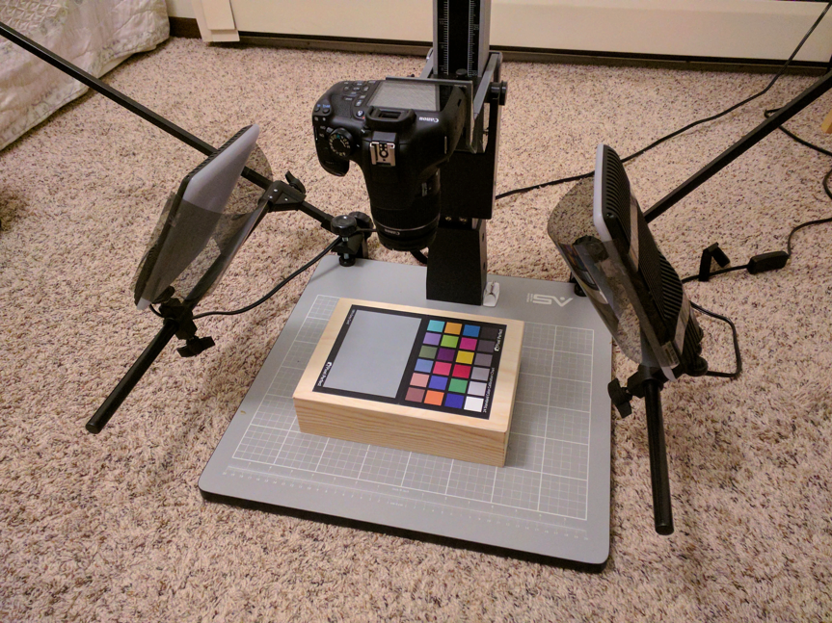
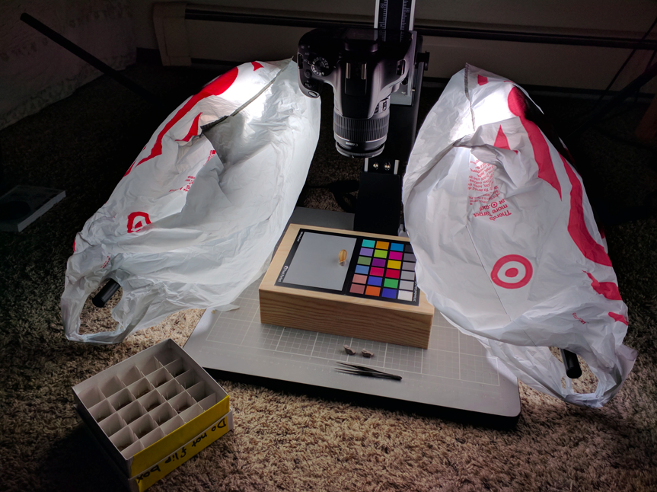
Morphological Data: Shell Brightness

Slide 46

Morphological Data: Shell Brightness

Slide 47

Morphological Data: Shell Brightness

Slide 48
Morphological Data: Shell Brightness
Shell images were analyzed to calculate mean gray value (MGV)
MGV is the sum of the gray values of all the pixels within the image selection divided by the number of pixels (gray value = (red + green + blue)/3)
MGV was used as a proxy for shell brightness

Slide 49
Linear Regression Analyses
Linear regression was done to test correlation between variation in morphological traits and latitude of sample locality

Slide 50



Morphological Trait vs. Latitude | Regression Statistics
 | R | R-Squared | S | DW | AIC | BIC
Shell Width 1 | 0.35408 | 0.12537 | 1.49958 | 0.85867 | 3.65317 | 3.67294
Shell Width 2 | 0.35948 | 0.12922 | 1.31912 | 0.84858 | 3.3967 | 3.41636
Shell Height | 0.34942 | 0.12209 | 0.99368 | 0.77917 | 2.83011 | 2.84981
Shell Brightness | 0.14243 | 0.02029 | 10.0922 | 1.73054 | 7.46885 | 7.49573

Slide 51

Morphological Trait vs. Latitude | Regression Statistics
 | R | R-Squared | S | DW | AIC | BIC
Shell Width 1 | 0.35408 | 0.12537 | 1.49958 | 0.85867 | 3.65317 | 3.67294
Shell Width 2 | 0.35948 | 0.12922 | 1.31912 | 0.84858 | 3.3967 | 3.41636
Shell Height | 0.34942 | 0.12209 | 0.99368 | 0.77917 | 2.83011 | 2.84981
Shell Brightness | 0.14243 | 0.02029 | 10.0922 | 1.73054 | 7.46885 | 7.49573

Slide 52


Slide 53
Summary
A minimum of 6 samples per population can be used to accurately estimate genetic diversity parameters in Webbhelix multilineata
Genetic structure suggests substantial differentiation among populations; genetic diversity consistent with range contraction and expansion; IBD is high in this species
Coalescent simulations preliminarily suggest refugial expansion in Webbhelix occurred following river corridors
Webbhelix appear to follow a converse Bergmann cline, and weakly follow a Gloger’s cline

Slide 54
Acknowledgements
So many people…
The EEOB department
Iowa State University

Slide 55

Questions

